Slide 1

AgrowCulture
Farm, Invest, Grow!!
Members:
Mohammad Ittehad Rahman Sami 200042131
Maliha Zaman 200042114
Nazia Karim Khan Oishee 200042137

Slide 2
Introduction
AgrowCulture is a web platform where we bring the people working hard in the agricultural sector in direct contact with the investors and buyers to aid their growth.
AgrowCulture enables Bangladesh agriculture financing as it offers an investment opportunity with attractive long term and short term investments.
1

Slide 3
Key Features
01
02
Funding
Selling
03
04
Investment
Purchase
2

Slide 4
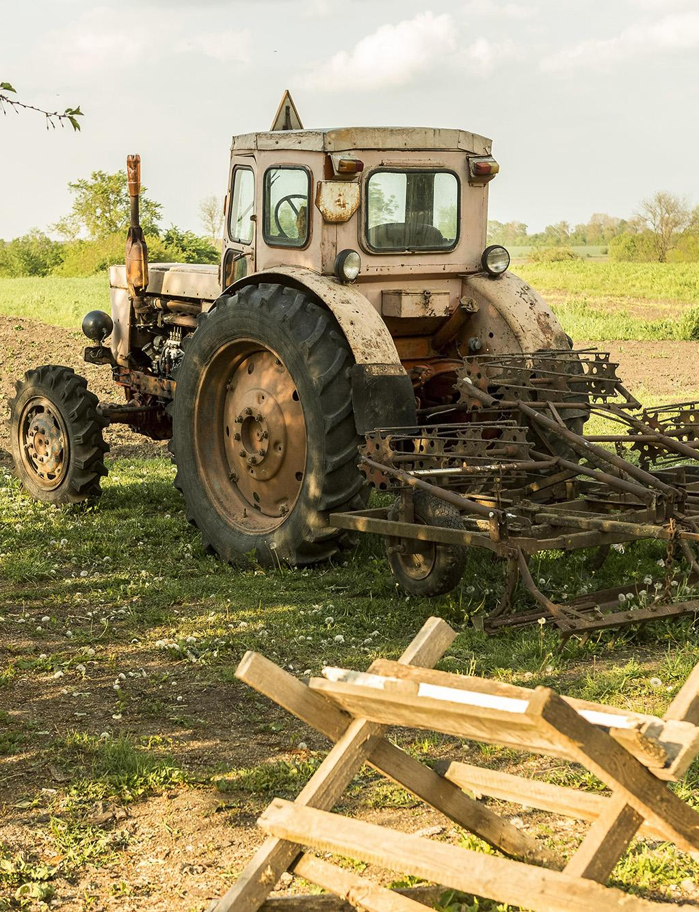
Funding
People working in the agricultural sector looking for financial help will be able to submit their plea.
3

Slide 5
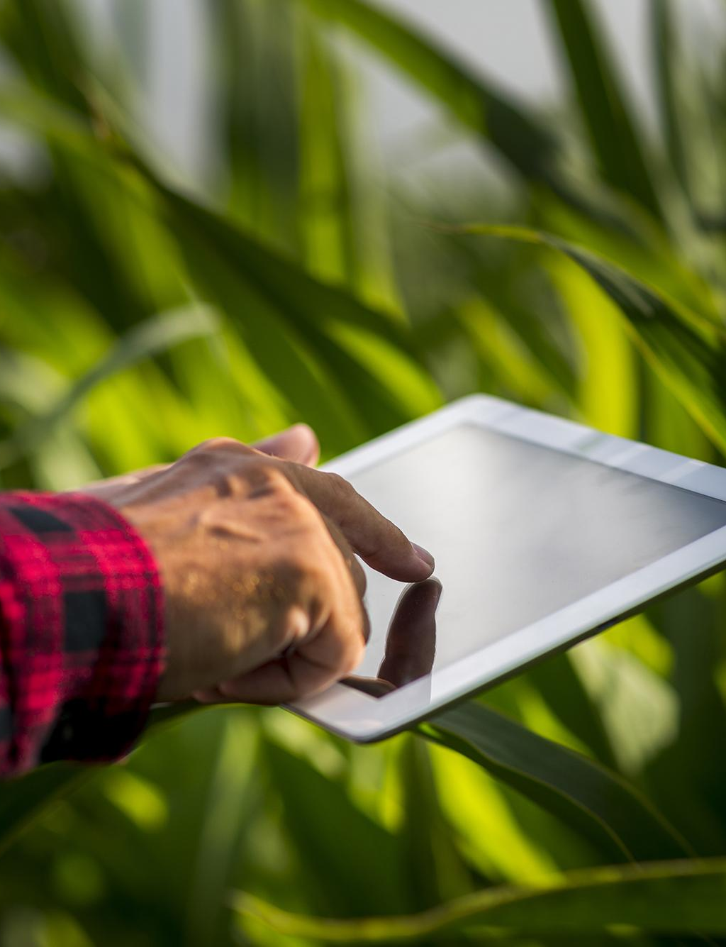
Investment
People can get into the world of investing by making investments through our website.
4

Slide 6

Selling
People can sell their products directly through our website.
5

Slide 7

Purchase
Buyers will be able to buy products through our website like other e-commerce platforms.
6

Slide 8
Why do we need this website?
Problem
Solution
Lack of capital, corrupted system, investment scam, contaminated food etc.
Available funding, reliable source to invest, fresh food etc.
7

Slide 9
Entity Relationship Diagram
8

Slide 10
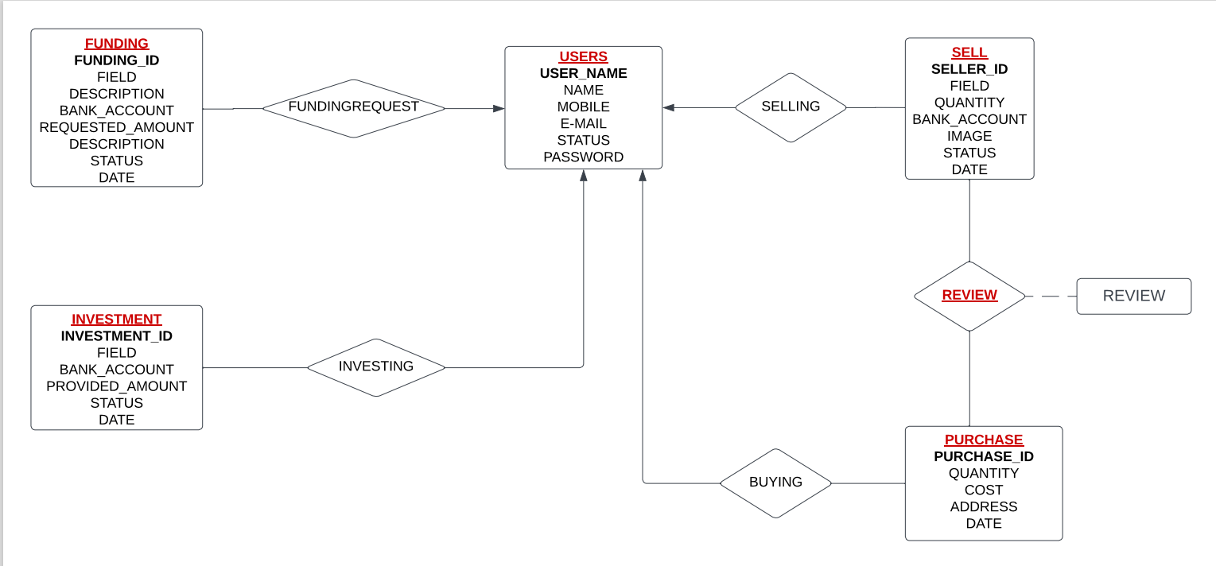
9

Slide 11
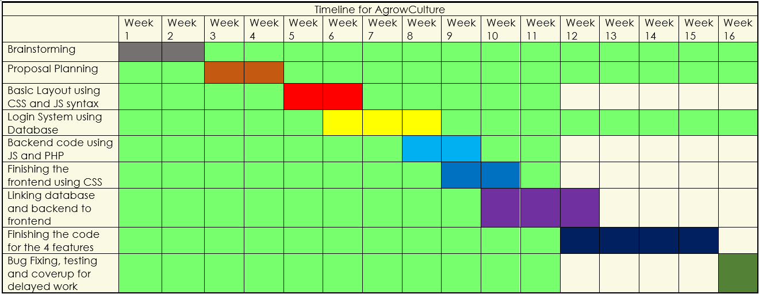
AgrowCulture Timeline
10

Slide 12
Demonstration of out work till date
11

Slide 13

Thank You

